Slide 1
Linear Regression
Shaurya Singhal
Anshu Kumar

Slide 2
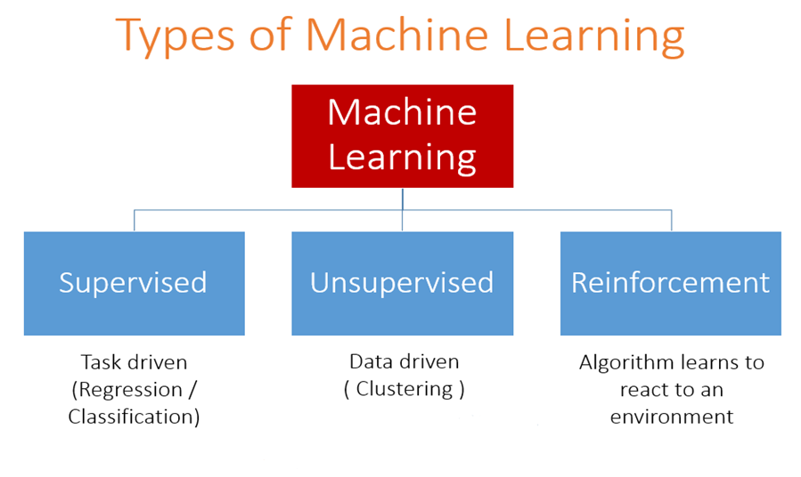

Slide 3
Univariate linear regression focuses on determining relationship between one independent variable(X) and one dependent variable(Y).
Univariate Linear Regression
Label(Y) (Number of hrs. study)
6.6
12
10
9.5
6
…..
X(CGPA)
7.8
9.4
8.8
8.3
7.3
…..

Slide 4
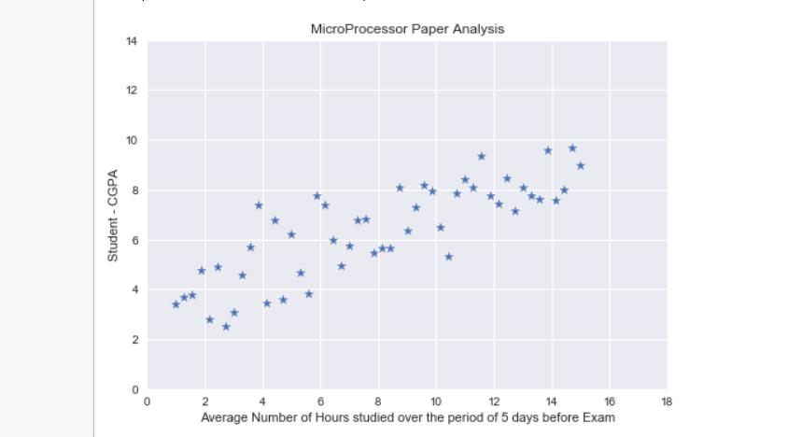
Dataset - How univariate data Looks like
Example : - CGPA Vs Hours of Study (Not Attendence)

Slide 5
Dataset Common Terminology
No. of Samples(m)
Input Features(n)
Training set
Test set
Hypothesis

Slide 6
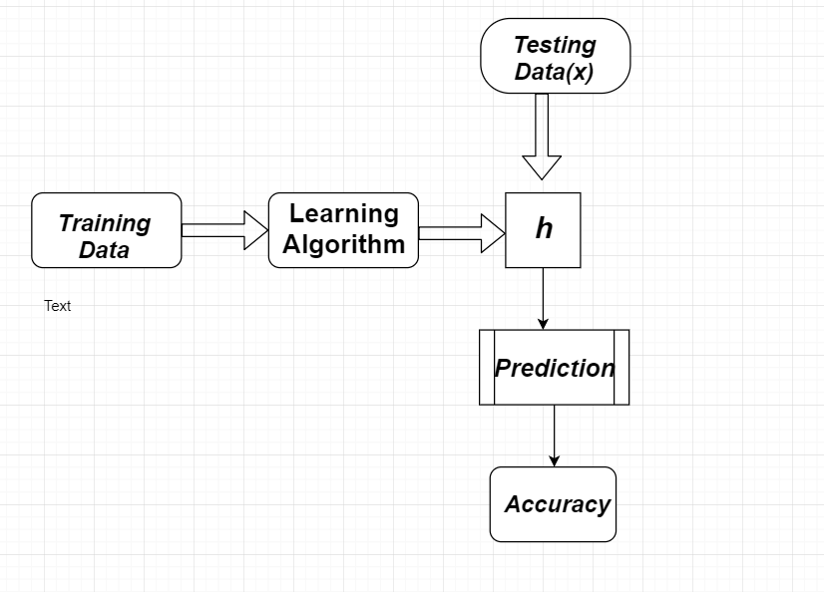
Aim and working (Pipeline)

Slide 7

Which line seems right ?

Slide 8
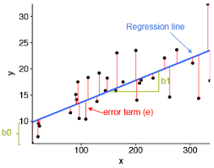
Q - How to find parameters(hypothesis) ?
Q - What is the measure of finding Best line ?
Ans - Error Function (How?)

Slide 9

Choice of Error Function
1.
-ve and +ve error added up

Slide 10

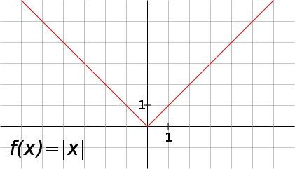
2.
Non-differentiable at (Ypred == Yactual)

Slide 11

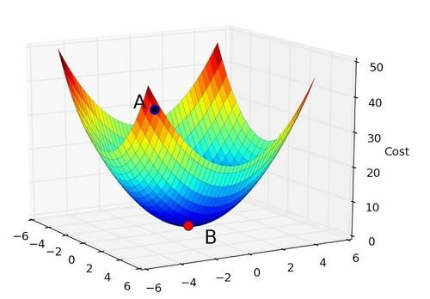
3.
Perfect, and this function is Convex in Nature(Helpful)

Slide 12
Goal - Minimizing the Error Function
An Iterative method to move toward the minimum point(using Gradient).
Gradient descent is an optimization algorithm used to minimize some function by iteratively moving in the direction of steepest descent as defined by the negative of the gradient. In machine learning, we use gradient descent to update the parameters of our model.
Gradient Descent

Slide 13
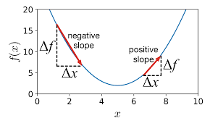
How we got the formulas of Gradient Descent ?

Slide 14

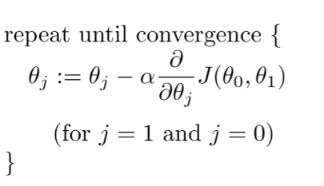
Updation Rule

Slide 15
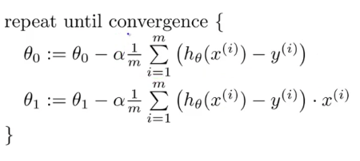
Derivative Derivation

Slide 16
Convergence Criteria
Number of Iteration
Change in Error

Slide 17
Let’s See the code (Working!)
Visualizing Line(Hypothesis)
Behaviour of Error Function using no. of iteration, change in error.
Variation of Learning rate
Visualizing Convex Function

